Slide 1




NABC+M Model
A Clear Framework for Defining and Communicating your Innovation

Slide 2
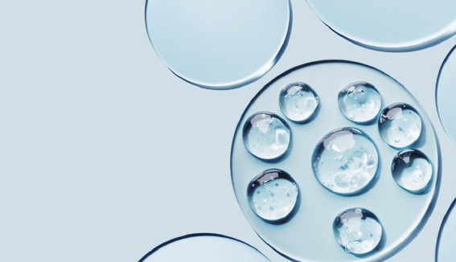

The NABC+M Model: Structuring Innovation Effectively
What is it?
What does it include?
Why use it?
The NABC model, developed by Stanford Research Institute International, is a structured approach to defining and evaluating innovations. It ensures that ideas are clear, compelling, and focused on real value. To enhance this framework for the Water Innovation Challenge, an additional element - Market Potential (M) - has been included.
While the original NABC model focuses on Customer Needs (N), Unique Approaches (A), Competitive Advantages/Benefits (B), and Competition (C), the added Market Potential (M) emphasizes the business opportunity. It helps innovators articulate the size, scalability, and adoption potential of their idea, making it more actionable for stakeholders, investors, and decision-makers.
Using NABC+M ensures that all submitted innovations follow a common structure, making them easier to compare, refine, and assess for real-world impact. You are encouraged to use this model in your submission to clearly communicate how your water innovation addresses a real need, stands out from alternatives, delivers value, and has the potential to scale.

Slide 3
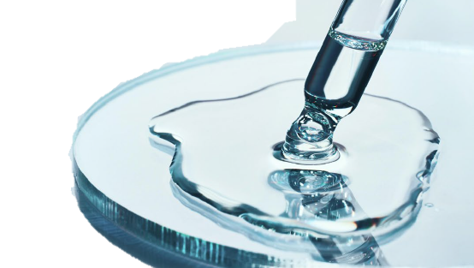
The NABC+M Model
Need
Approach
Benefits
Competition
Market
What is the significant customer or market need? Where lies our opportunity? Who are our customers?
How does our solution uniquely address this need? How do we provide it?
What unique value does our solution provide to the customer and to us?
What existing solutions already address this need, and how does our approach compare?
Quantify your market size and customer base, including the addressable market and growth opportunities.
Customer Perspective
Internal Perspective
Value Perspective
External Perspective
Business Perspective

Slide 4
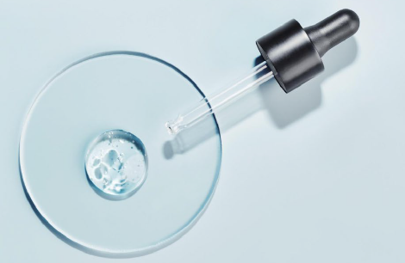
Example:
AquaPure – Smart Water Filtration for Remote Areas
Need
Approach
Benefits
Competition
Market
Millions of people in remote and underserved areas lack access to clean drinking water. Existing filtration solutions are either too expensive, require infrastructure, or do not effectively remove contaminants.
AquaPure is a portable, solar-powered water filtration device that uses advanced nanotechnology to purify water from any source. Unlike traditional filters, it requires no electricity, has self-cleaning capabilities, and lasts five years without replacement.
AquaPure provides safe drinking water at a fraction of the cost of bottled water or traditional purification systems. It reduces health risks from contaminated water, lowers dependency on expensive filtration methods, and offers a sustainable, long-term solution with minimal maintenance.
Alternatives include chlorine tablets, traditional water filters, and large-scale purification systems. However, AquaPure is superior because it removes more contaminants, is more cost-effective over time, and does not rely on chemicals or frequent filter replacements.
AquaPure's addressable market exceeds 2 billion people lacking clean water, with an initial target of 500 million in remote areas, disaster relief efforts, and outdoor recreation. The global water filtration market is valued at $50 billion, growing at 7% annually, driven by rising water safety concerns and demand for sustainable, chemical-free solutions.
Customer Perspective
Internal Perspective
Value Perspective
External Perspective
Business Perspective

Slide 5
NABC+M Template
Instructions:
Export this slide and the next five slide.
Fill out the slides with information related to your company/idea
Once completed, submit your competition entry to wic@sbdev.com
Company / Project:
Established Year (if company):
Number of Employees (if any):
Revenue (if any):
Website (if any):
Team:
Contact Person:

Slide 6
Need
Company / Project:
Customer Perspective

Slide 7
Approach
Company / Project:
Internal Perspective

Slide 8
Benefits
Company / Project:
Value Perspective

Slide 9
Competition
Company / Project:
External Perspective

Slide 10
Market
Company / Project:
Business Perspective

